Slide 1



Dr. Hiba Shakir Ahmed
Microbiology / Clinical Immunology

Slide 2
ENTERIC VIRUSES & RHINOVIRUSES
Lecure 8

Slide 3
Enteroviruses are transient inhabitant of the human alimentary tract and may be isolated from throat or lower intestinal tract.
Rhinoviruses are isolated chiefly from the nose and throat (common cold virus(.
Many picornaviruses (enterovirus & rhinovirus) cause diseases in human ranging from severe paralysis to aseptic meningitis , myocarditis , vesicular , exanthematous , skin lesion and respiratory illness.
The virion of picornaviruses consist of a capsid shell of 60 subunits each of four proteins (VP1-VP4) arranged with icosahedral symmetry around a genome made up of a linear single strand of Positive sense-RNA , RNA range from 7.2-8.4 kb in size , none enveloped viruses.

Slide 4
Poliomyelitis : Is an acute infectious disease that in its serious form affects the central nervous system. The destruction of motor neurons in the spinal cord results in flaccid paralysis .
Laboratory Diagnosis :
The virus may be recovered from throat swabs taken soon after onset of illness and from rectal swabs or stool sample collected over long periods , Poliovirus is uncommonly recovered from the cerebrospinal fluid .

Slide 5
Lecture 9
HERPES VIRUSES

Slide 6
HERPES VIRUSES
The herpes virus family contains several of the most important human pathogens , Clinically , the herpes viruses exhibit a spectrum of diseases some have wide host range whereas others have a narrow host-cell range.
The outstanding property of herpes viruses is their ability to establish lifelong persistent infections in their hosts and to undergo periodic reactivation. Herpes viruses possess a large number of genes, some of which have proved to be susceptible to antiviral chemotherapy.
The herpes viruses that commonly infect humans include herpes simplex virus type 1 & 2 (HSV 1 and 2) , Varicella-Zoster (VZ) virus , Epstein-Barr virus (EB) , Cytomegalovirus (CMV) , human herpesviruses 6 & 7 and herpes virus 8. Herpes B virus of monkeys can also infect humans.

Slide 7
All herpes viruses have a core of linear double-strand DNA in the form of toroid surrounded by a protein coat that exhibits icosahedral symmetry and has 162 capsomeres.
The nucleic acid is surrounded by an envelope that is derived from the nuclear membrane of the infected cell and contains viral glycoprotein.
The base composition of herpes viruses DNAs varies there is little DNA homology among different herpes except for HSV 1 and 2 (50% homology) , HV 6 and 7 (30-50% homology.(

Slide 8
Herpes simplex virus
They are responsible for a spectrum of diseases ranging from gingivostomatitis to Keratoconjunctivitis , encephalitis , genital diseases , and infections of newborns HVS establish latent infections in nerve cells recurrences are common.
Laboratory Diagnosis
A- Isolation & identification of viruses :
Virus may isolated from herpetic lesion and may also be found in throat washings, CSF, and stool, both during primary infection and during asymptomatic periods.
B- PCR & Hybridization :
PCR assay can be used to detect virus and are sensitive and specific. PCR amplification of viral DNA from CSF has replaced viral isolation from brain tissue.
C- Serology :
Antibodies appear in 4-7 days after infection and reach a peak in 2-4 weeks. The diagnostic value of serologicl assay is limited by the multiply antigens.

Slide 9
Cytomegalovirus (CMV)
CMV are ubiquitous herpes viruses that are common causes of human disease the name for classic cytomegalic inclusion disease derived from
the propensity for massive enlargement of cytomegalovirus infected cells.
Cytomegalic inclusion disease is a generalized infection of infants caused by intrauterine or early postnatal infection with CMV. CMV poses an important public health problem because of its high frequency of congenital infections which may lead to severe congenital anomalies.

Slide 10
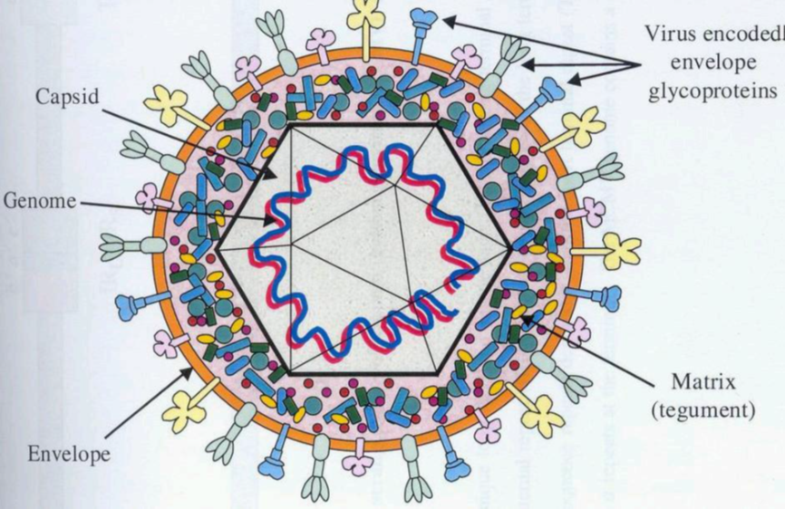
Virion of CMV

Slide 11
Laboratory Diagnosis
A- PCR & Antigen detection assay :
PCR assay are designed to detect replicating virus , blood and urine are most commonly tested , antibodies against viral antigens can be used to detect virus-positive in patients.
B- Serology :
Detection of IgG antibodies by using ELISA indicative of past infection while detection of viral IgM refer to a current infection.
C- Isolation of virus :
Human fibroblasts cell culture are used for virus isolation attempts , the virus can be recovered most readily from throat washing and urine. Incubation for 2-3 weeks are needed to appear the cytological changes.

Slide 12


